Slide 1




Testing The Web
… Quelle idée!
Raed Chammam
<raed.chammam@gmail.com>
19/10/2017

Slide 2
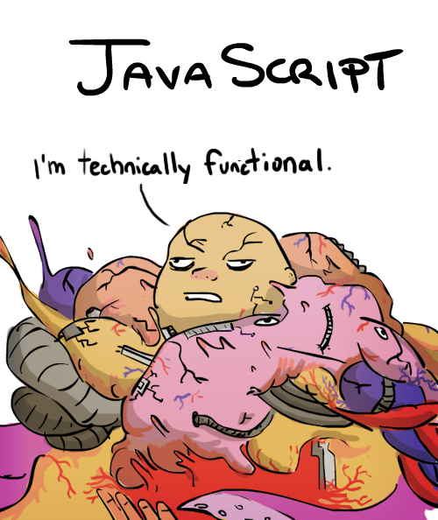

Automated Testing
Educational minimum
Functional !?
Notes:
Quand on code :
Imaginer ce qu’on peut faire en fonctions
Quel paramètres donne quels résultats
Code and run until it works … imperfect approch as we might miss edge cases..
Tests separate from the code

Slide 3
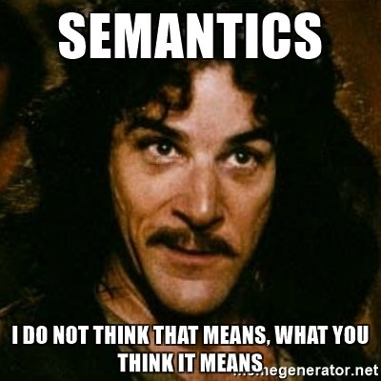
Semantics
Unit Testing
Integration testing
2E2, TDD, BDD, WTF!
“Unit of Code”→ function (simple, quick)
“TDD” → Write your test before your code (code-coverage)
“BDD”→ Test behavior not implementation (no implied values or behavior) “self contained”

Slide 4
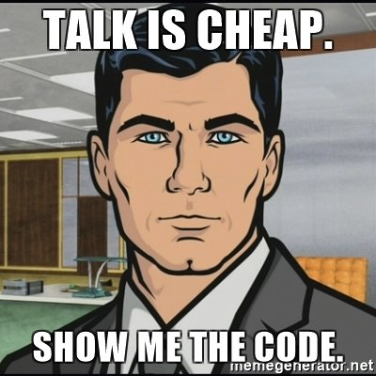
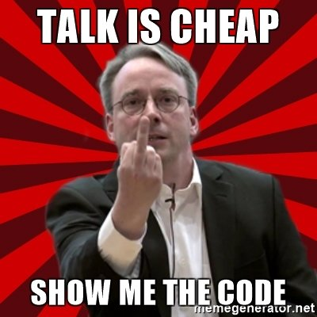


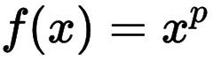
Show Me The Code!
Editor time !
Modern browser
Node.js > 6
function pow(x, p)

Slide 5
Thank you
Raed Chammam <raed.chammam@gmail.com>
raed.it | raed.tn
https://github.com/RaedsLab/TestingTheWeb/

